Slide 1
Sequence vs. Other Data Representations

Slide 2



Sequence vs. itemset / vector
itemset:
{ } = { } = { }
vector:
{ } ≠ { } = { }
sequence:
{ } ≠ { } ≠{ }
Itemset:
Order does not matter
Repeated occurrence of item does not matter
Vector:
Order does not matter
Repeated occurrence of item does matter
Sequence:
Order does matter
Repeated occurrence of item does matter
Emoji - Mozilla - https://commons.wikimedia.org/wiki/Category:Firefox_OS_Emoji - CC-BY

Slide 3
Sequence of vectors
A generalization from sequence of items
x_{k} is a vector of p dimensions
p numerical attributes to describe an item
p dimensions are aligned in x₁, x₂ , …, x_{k}

Slide 4
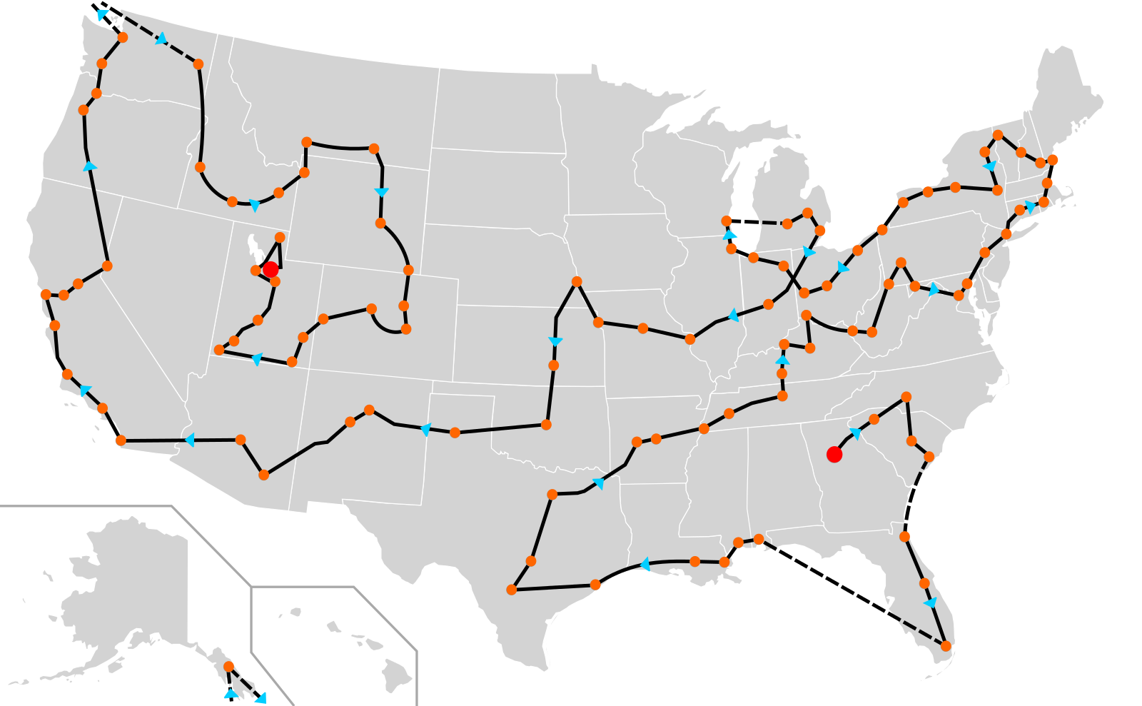
Example: sequence of vectors
Trajectory → sequence of locations;
Every location as a 2D vector
longitude
latitude
2002 Winter Olympics Torch Relay Route
Mangoman88 - https://commons.wikimedia.org/wiki/File:2002_Winter_Olympics_torch_relay_route.svg - CC-BY-SA 3.0

Slide 5
Sequence of vectors vs. matrix
Sequence of vectors is closely related to a k x p matrix (or p x k after transpose)
x₁
x₁₁ | ... | x_{1j} | ... | x_{1p}
... | ... | ... | ... | ...
x_{i1} | ... | x_{ij} | ... | x_{ip}
... | ... | ... | ... | ...
x_{k1} | ... | x_{kj} | ... | x_{kp}
x₁₁ | ... | x_{i1} | ... | x_{k1}
... | ... | ... | ... | ...
x_{1j} | ... | x_{ij} | ... | x_{kj}
... | ... | ... | ... | ...
x_{1p} | ... | x_{ip} | ... | x_{kp}
...
k ordered vectors
x_{i}
p attributes
...
x_{k}
x₁
...
x_{k}
p attributes
k ordered vectors

Slide 6
Sequence of vectors vs. matrix
Sequence of vectors is closely related to a k x p matrix (or p x k after transpose)
But the rows (k objects) now have an order and cannot be rearranged.
Must be careful when applying PCA style dimension reduction.

Slide 7
Sequence of vectors vs. time series
Sequence of Vectors
Time Series
List of vectors with a fixed order
Sequence of numerical values (of a homogeneous attribute)
Order of vectors matter
Order of values matter
Absolute position does not matter
Absolute position (timestamp)
does matter

Slide 8
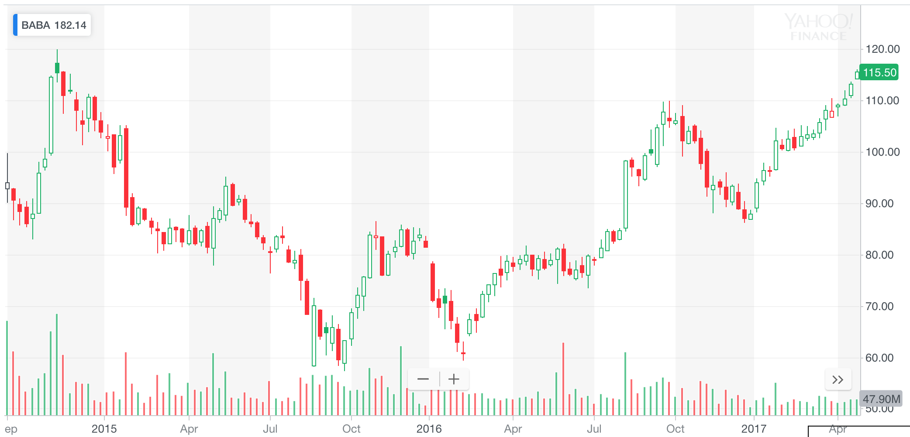
Example of time series
p attributes
k samples, not only ordered but also timestamped!
Investopedia (https://www.investopedia.com/university/technical/techanalysis8.asp)

Slide 9
Examples of Sequence and Time Series
Sequence:
“You take these courses in order, but can choose to take them in different semesters.”
Time series:
“You have to take these courses in order and at an exact time.”

Slide 10


School of Information, University of Michigan
Qiaozhu Mei
School of Information
All Content © Presenter

